Slide 1


Neural network for very short-term hydrological forecasting
Master’s Dissertation in Applied Computing
Cintia Pereira de Freitas
Advisor: Dr. Leonardo Bacelar Lima Santos
March/2022

Slide 2
Outline
Introduction
Case study 2
Data and method
Results
Conclusion
Conceptual context
Case study 1
Data and method
Results
Conclusion
Further and comparative analyzes
Final remarks
References
2

Slide 3
Introduction

Slide 4

Introduction
Extreme hydrological events:
+ Frequency
+ Severity
quintupled between 1970 - 2019
Brazil: Experienced 193 disasters
Fonte: The Atlas of Mortality and Economic Losses from Weather, Climate and Water Extremes (1970–2019)
4

Slide 5
Scientific Question
Is it possible to use models based on ANN for very short-term hydrological forecasting?
5

Slide 6
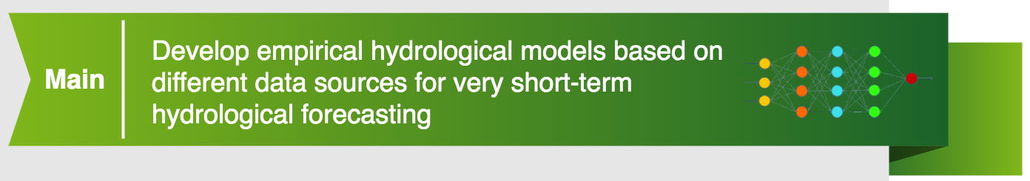


Goals
6

Slide 7


Goals
7

Slide 8

Goals
8

Slide 9
Conceptual Context

Slide 10
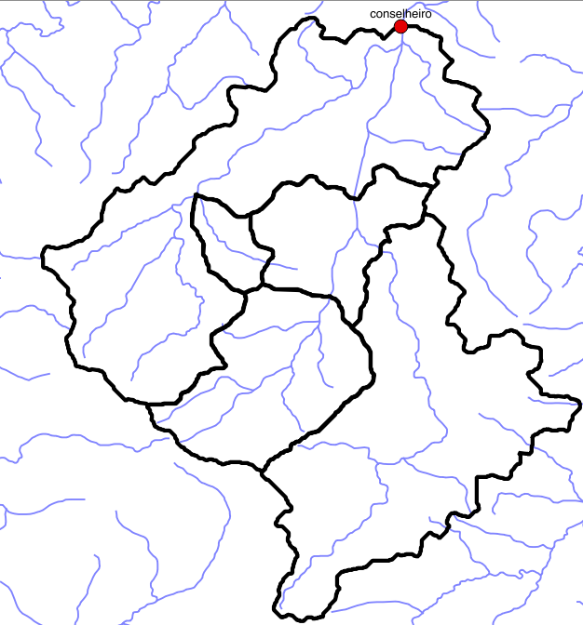
Watershed outlet
Outlet
Lowest watershed point
10

Slide 11
Concentration time
Is the time required for water to flow from hydraulically most distant point in the watershed to the outlet
11

Slide 12
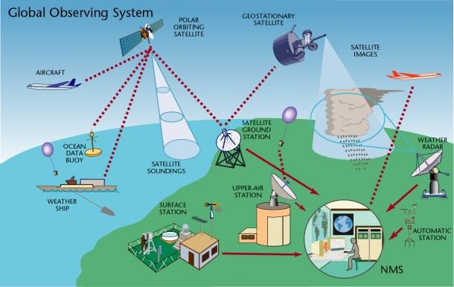
Weather and hydrological data
Source: https://public.wmo.int/en/programmes/global-observing-system
12

Slide 13
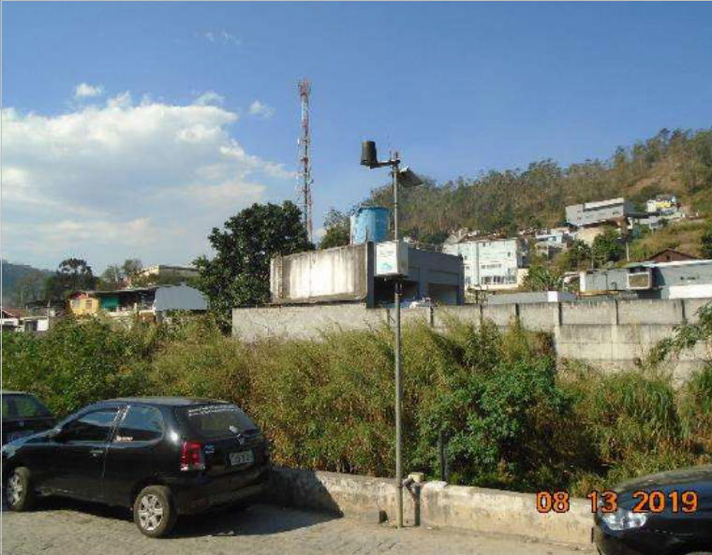
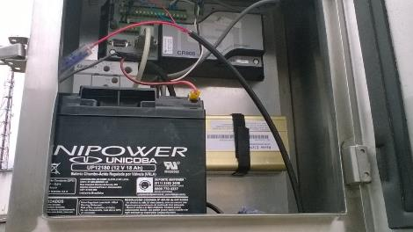
Station
Telemetry station
Source: INEA
13

Slide 14
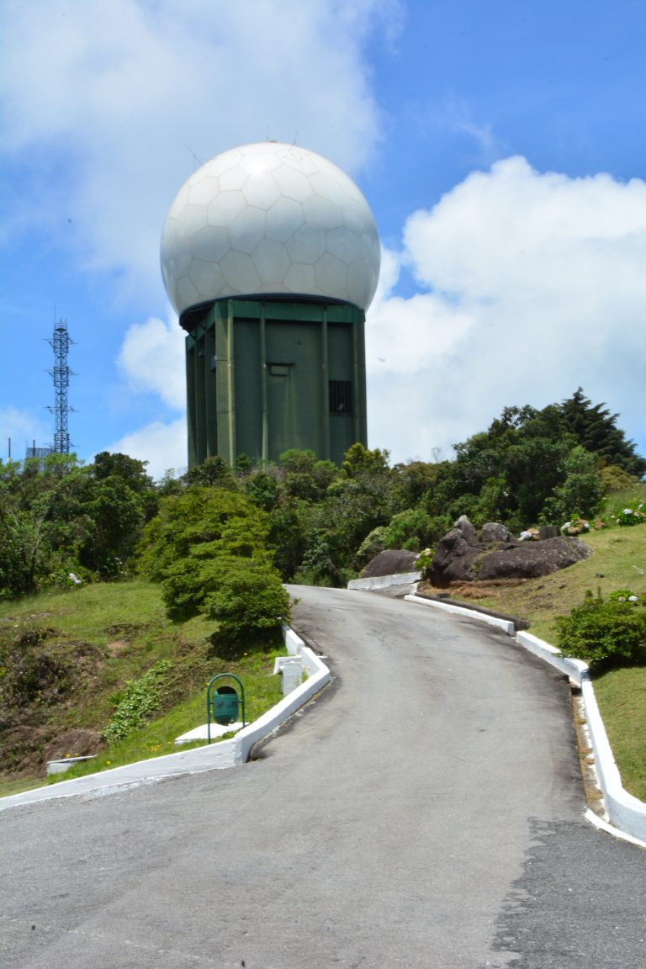
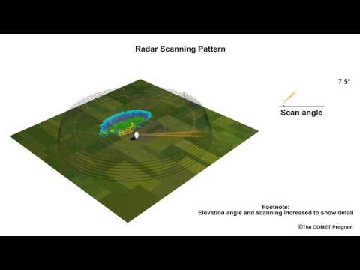
Weather radar
Radar operation
Source: https://tribunadepetropolis.com.br/
14

Slide 15
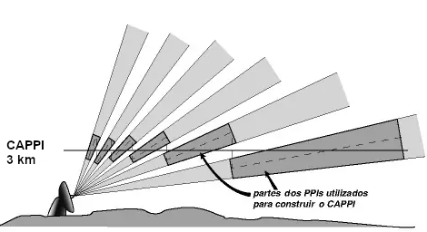
Weather radar
CAPPI (Constant Altitude Plan Position Indicator)
Source: https://www.monolitonimbus.com.br
15

Slide 16
ANN
Any technique that enables computers to mimic human intelligence
Artificial Intelligence
A set of algorithms to analyze data, learn from it, and then determine or predict a set of events
Machine Learning
Neural Networks
Computational model whose structure is based on the biological neural network model
16

Slide 17
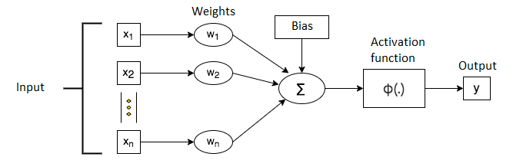
ANN - Artificial neuron
Representation of an artificial neuron
17

Slide 18
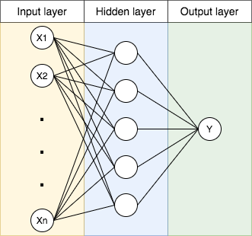
ANN - Multilayer Perceptron
18

Slide 19
A literature overview
Paper | Type | Input | Output | Temporal domain | Metrics
Kia et al. (2012) | MLP | Elevation, slope, flow accumulation, geology, land use, soil, rainfall | Water level | 1987 - 2006 | R², SSE MSE RMSE = 2,4-23
Lima et al. (2016) | MLP | Rainfall 8 stations Water level 7 stations | Water level 1 station 15 and 120 minutes | 15 minutes 2013-2014 Train: 01/2013 - 06/2014 Test: 07/2014 - 11/2014 | ME, MAE NSE RMSE = 0.0150
SUNG et al. (2017) | MLP | 4 stations Rainfall and Water level | Water level 1, 2 and 3 hours | Hourly 2007–2016 | R² NSE RMSE = 0.0502
Nur Adli Zakaria et al. (2021) | MLP ANFIS | Water level | Water level 1-hour to 24-hour | 2008 to 2018 | R², MAPE, WI RMSE = 0.0129
19

Slide 20
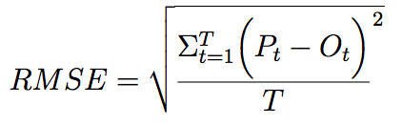
Metrics - RMSE
Root mean square error (RMSE)
P_{t}
= predicted at time t
O_{t}
= observed at time t
T
= discrete values
20

Slide 21
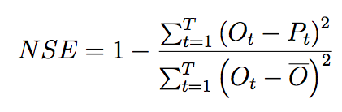
Metrics - NSE
Nash–Sutcliffe model efficiency coefficient (NSE)
P_{t}
= predicted at time t
O_{t}
= observed at time t
O
= mean of the observed in the time interval [1,T]
21

Slide 22
Empirical hydrological forecast with data from hydrological stations
Case study 1:

Slide 23

Case study 1
23

Slide 24
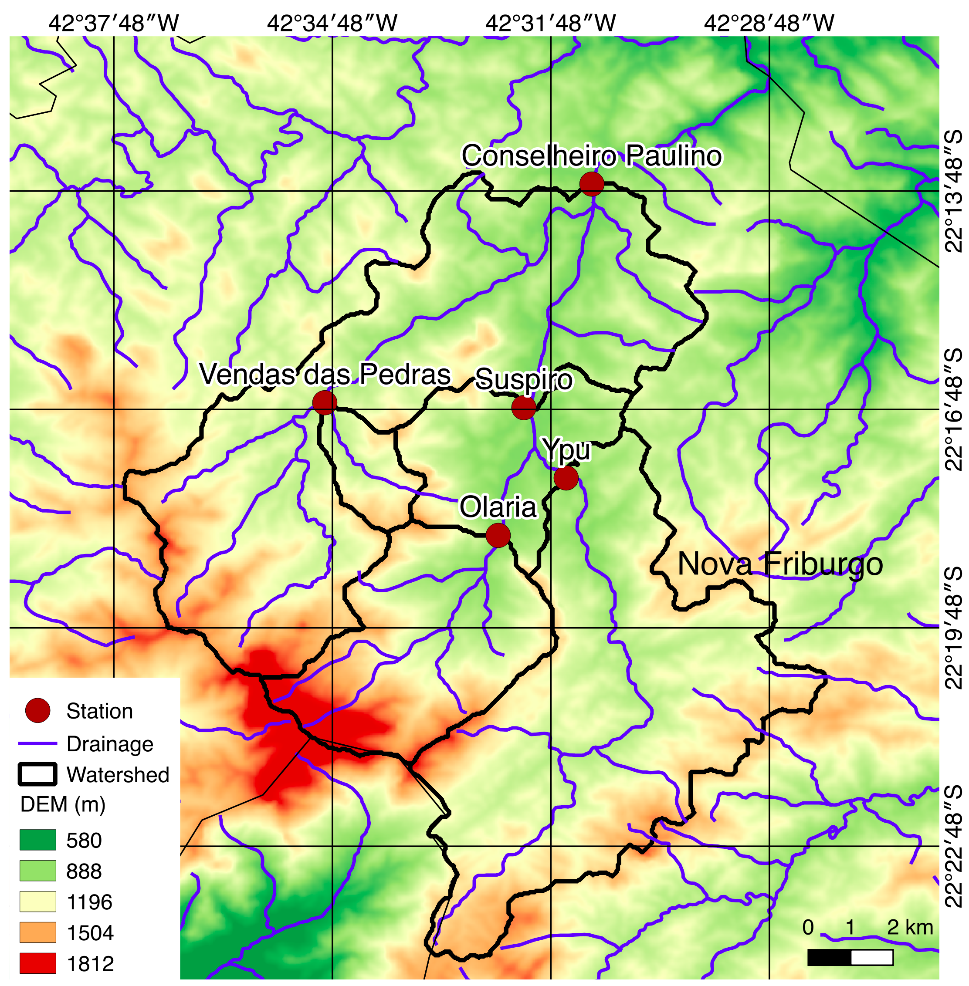
Study area
Rio Grande subwatershed, located in Nova Friburgo, mountain region of RJ
Rio Bengalas watershed
Drainage area ~ 190 km²
Concentration time ~ 2 hours
Source: author production
24

Slide 25
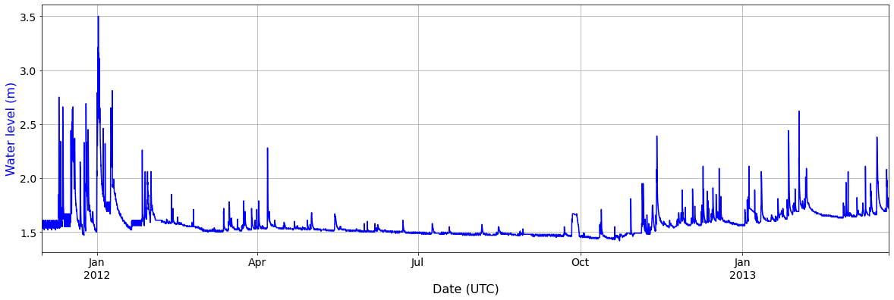
Target
Water level - Conselheiro Paulino
Source: author production
25

Slide 26


Case study 1 - Input data
5 hydrologic monitoring stations of the INEA institute
acquired with a 15-minute resolution
rainfall and water level data
December 1, 2011 and March 24, 2013
Samples: 46752 (~100%)
26

Slide 27
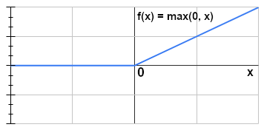
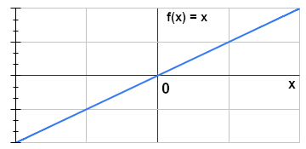
Case study 1 - Architecture
Multilayer perceptron
1 hidden layer with 5 neurons
Activation function: ReLU (Hidden layer)
Linear (Output layer)
ReLU (Rectified Linear Unit)
Linear
27

Slide 28
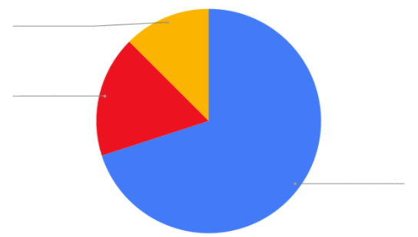
Case study 1 - Split data
Test
12.5%
Validation
17.5%
Train
70%
Train, Validation: Shuffle
Test: Feb and Mar, 2013
28

Slide 29
Case study 1 - Target data
Water level to Conselheiro Paulino
To: 15, 30, 45, 60, 75, 90, 105 and 120 minutes in advance
29

Slide 30
Case study 1 - Set of tests
Three tests:
Input: only water level data (5 stations) - 5 neurons
Input: only rainfall data (5 stations) - 5 neurons
Input: both water level and rainfall data (5 stations) - 10 neurons
30

Slide 31
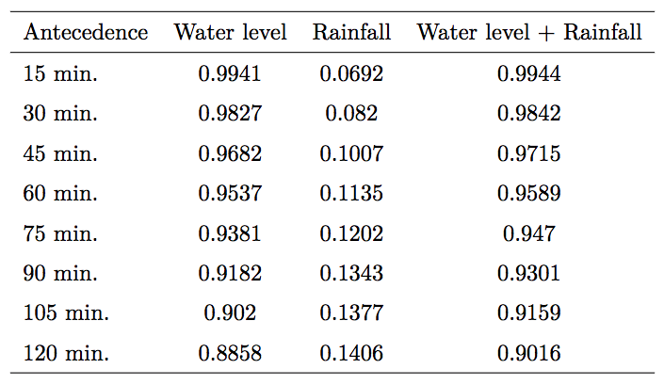
Case study 1 - Results - NSE
Values of NSE for the different predictions
Source: author production
31

Slide 32
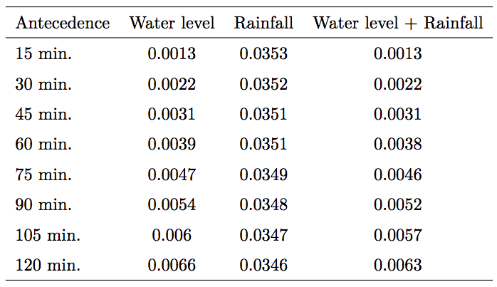
Case study 1 - Results - RMSE
Values of RMSE for the different predictions
Source: author production
32

Slide 33
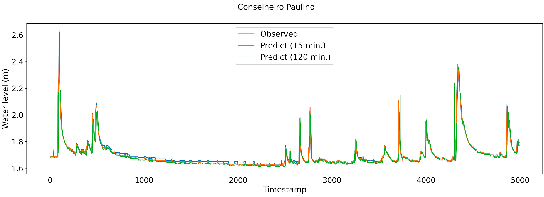
Case study 1 - Results
Observed and Predicted values
Source: author production
33

Slide 34
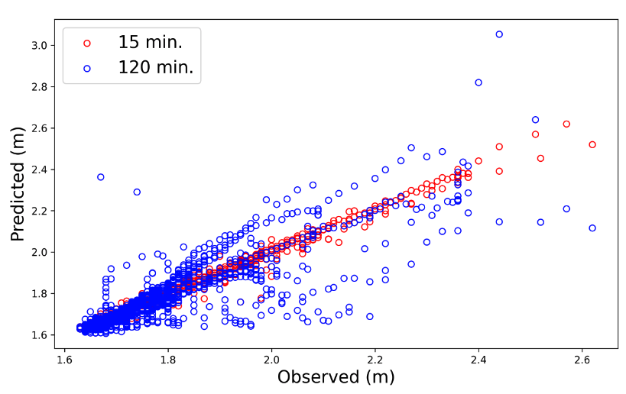
Case study 1 - Results
Scatter plot between predicted and observed values
Source: author production
34

Slide 35
Case study 1 - Conclusions
Good agreement for 15 minutes forecast
Good agreement even for 2 hours forecast
Predictions using only rainfall data did not succeed
Current
RNA
Future
35

Slide 36
Case study 2:
Empirical hydrological forecast with data from weather radar

Slide 37
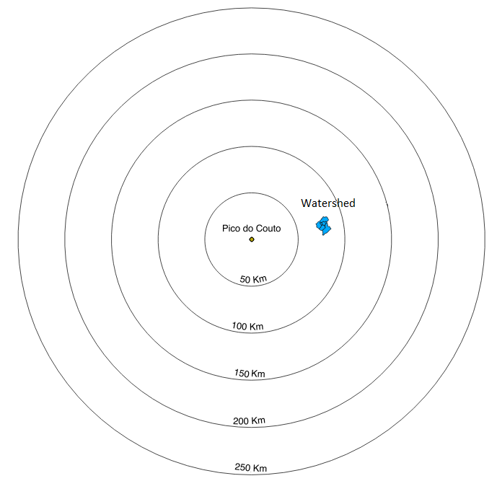
Case study 2 - Input data
Radar Pico do Couto - DECEA
Spatial Resolution: ~ 1km
Temporal Resolution: 15 min.
Product: CAPPI - 3km
01/12/2011 - 31/03/2013
December 1, 2011 and March 24, 2013
Samples: 32271
(~69% of the total)
Source: author production
37

Slide 38
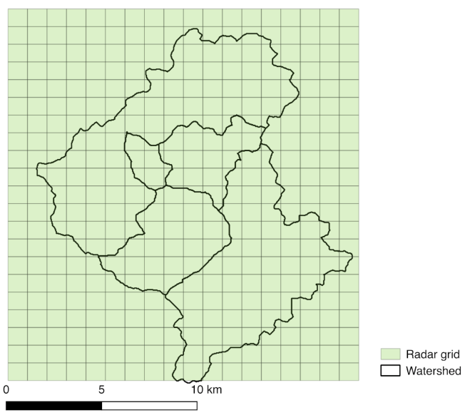
Case study 2 - Input data
378 radar grid points
Source: author production
38

Slide 39
Case study 2 - Data conversion
Z-R Equation:
Estimated constants
Z = aR^{b}
Reflectivity (dBZ)
Rain rate (mm/h)
Marshall Palmer Equation:
Z = 200R^{1.6}
39

Slide 40
Case study 2 - Split data
Test
10%
Validation
10%
Train
80%
Train, Validation and Test: Shuffle
40

Slide 41
Case study 2 - Target data
Water level to Conselheiro Paulino
To: 15 and 120 minutes in advance
41

Slide 42
Case study 2 - Architecture
Multilayer perceptron
3 hidden layers with 120, 50 and 10 neurons
Activation function: ReLU (Hidden layer)
Linear(Output layer)
ReLU (Rectified Linear Unit)
Linear
42

Slide 43
Case study 2 - Set of tests
Different inputs:
Current (dBZ)
Current (mm/h)
Acc. 1 hour (mm)
Acc. 2 hours (mm)
Acc. 6 hours (mm)
Acc. 12 hours (mm)
Acc. 24 hours (mm)
Acc. 48 hours (mm)
43

Slide 44
Case study 2 - Results - 15 minutes
Input | Epochs | RMSE Test | NSE Test
Current (dBZ) | 119 | 0.1053 | -0.2567
Current (mm/h) | 266 | 0.0983 | -0.0882
Acc. 1 hour (mm) | 270 | 0.0743 | 0.5486
Acc. 2 hours (mm) | 351 | 0.0572 | 0.6996
Acc. 6 hours (mm) | 152 | 0.0601 | 0.7099
Acc. 12 hours (mm) | 241 | 0.0380 | 0.8779
Acc. 24 hours (mm) | 186 | 0.0329 | 0.8769
Acc. 48 hours (mm) | 179 | 0.0391 | 0.8495
Source: author production
44

Slide 45
Case study 2 - Results - 120 minutes
Input | Epochs | RMSE Test | NSE Test
Current (dBZ) | 113 | 0.1033 | -0.1978
Current (mm/h) | 249 | 0.0972 | -0.2122
Acc. 1 hour (mm) | 331 | 0.0754 | 0.4929
Acc. 2 hours (mm) | 258 | 0.0650 | 0.6621
Acc. 6 hours (mm) | 266 | 0.0434 | 0.7960
Acc. 12 hours (mm) | 183 | 0.0416 | 0.8590
Acc. 24 hours (mm) | 186 | 0.0366 | 0.8588
Acc. 48 hours (mm) | 123 | 0.0508 | 0.7792
Source: author production
45

Slide 46
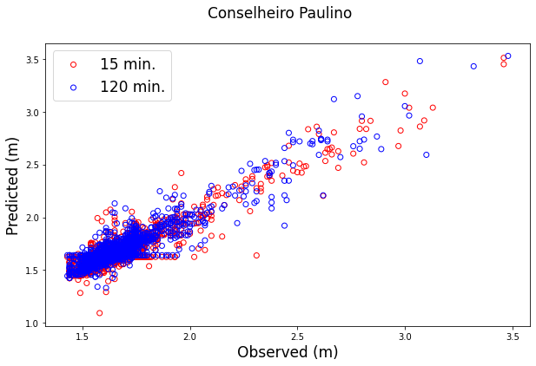
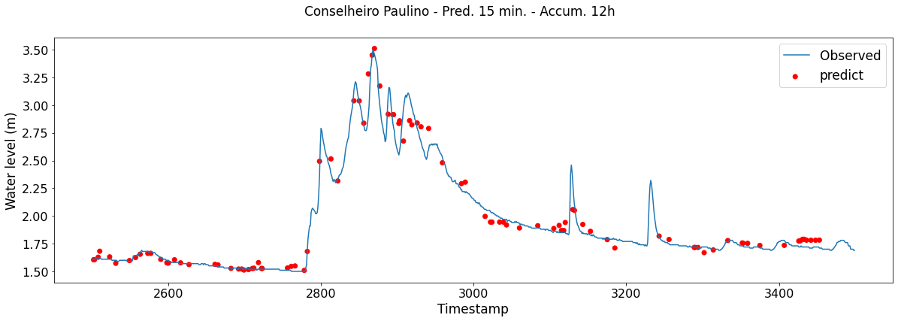
Case study 2 - Results
Observed and Predicted values
Source: author production
46

Slide 47
Case study 2 - Conclusions
Even in a watershed with a concentration time of less than 2h, the network showed a better performance with accumulated rainfall greater than 6h - physical system’s memory, which may have some relation with soil moisture
Good agreement even with only rainfall as a input
Past
Current
RNA
Future
47

Slide 48
Further and comparative analyzes

Slide 49
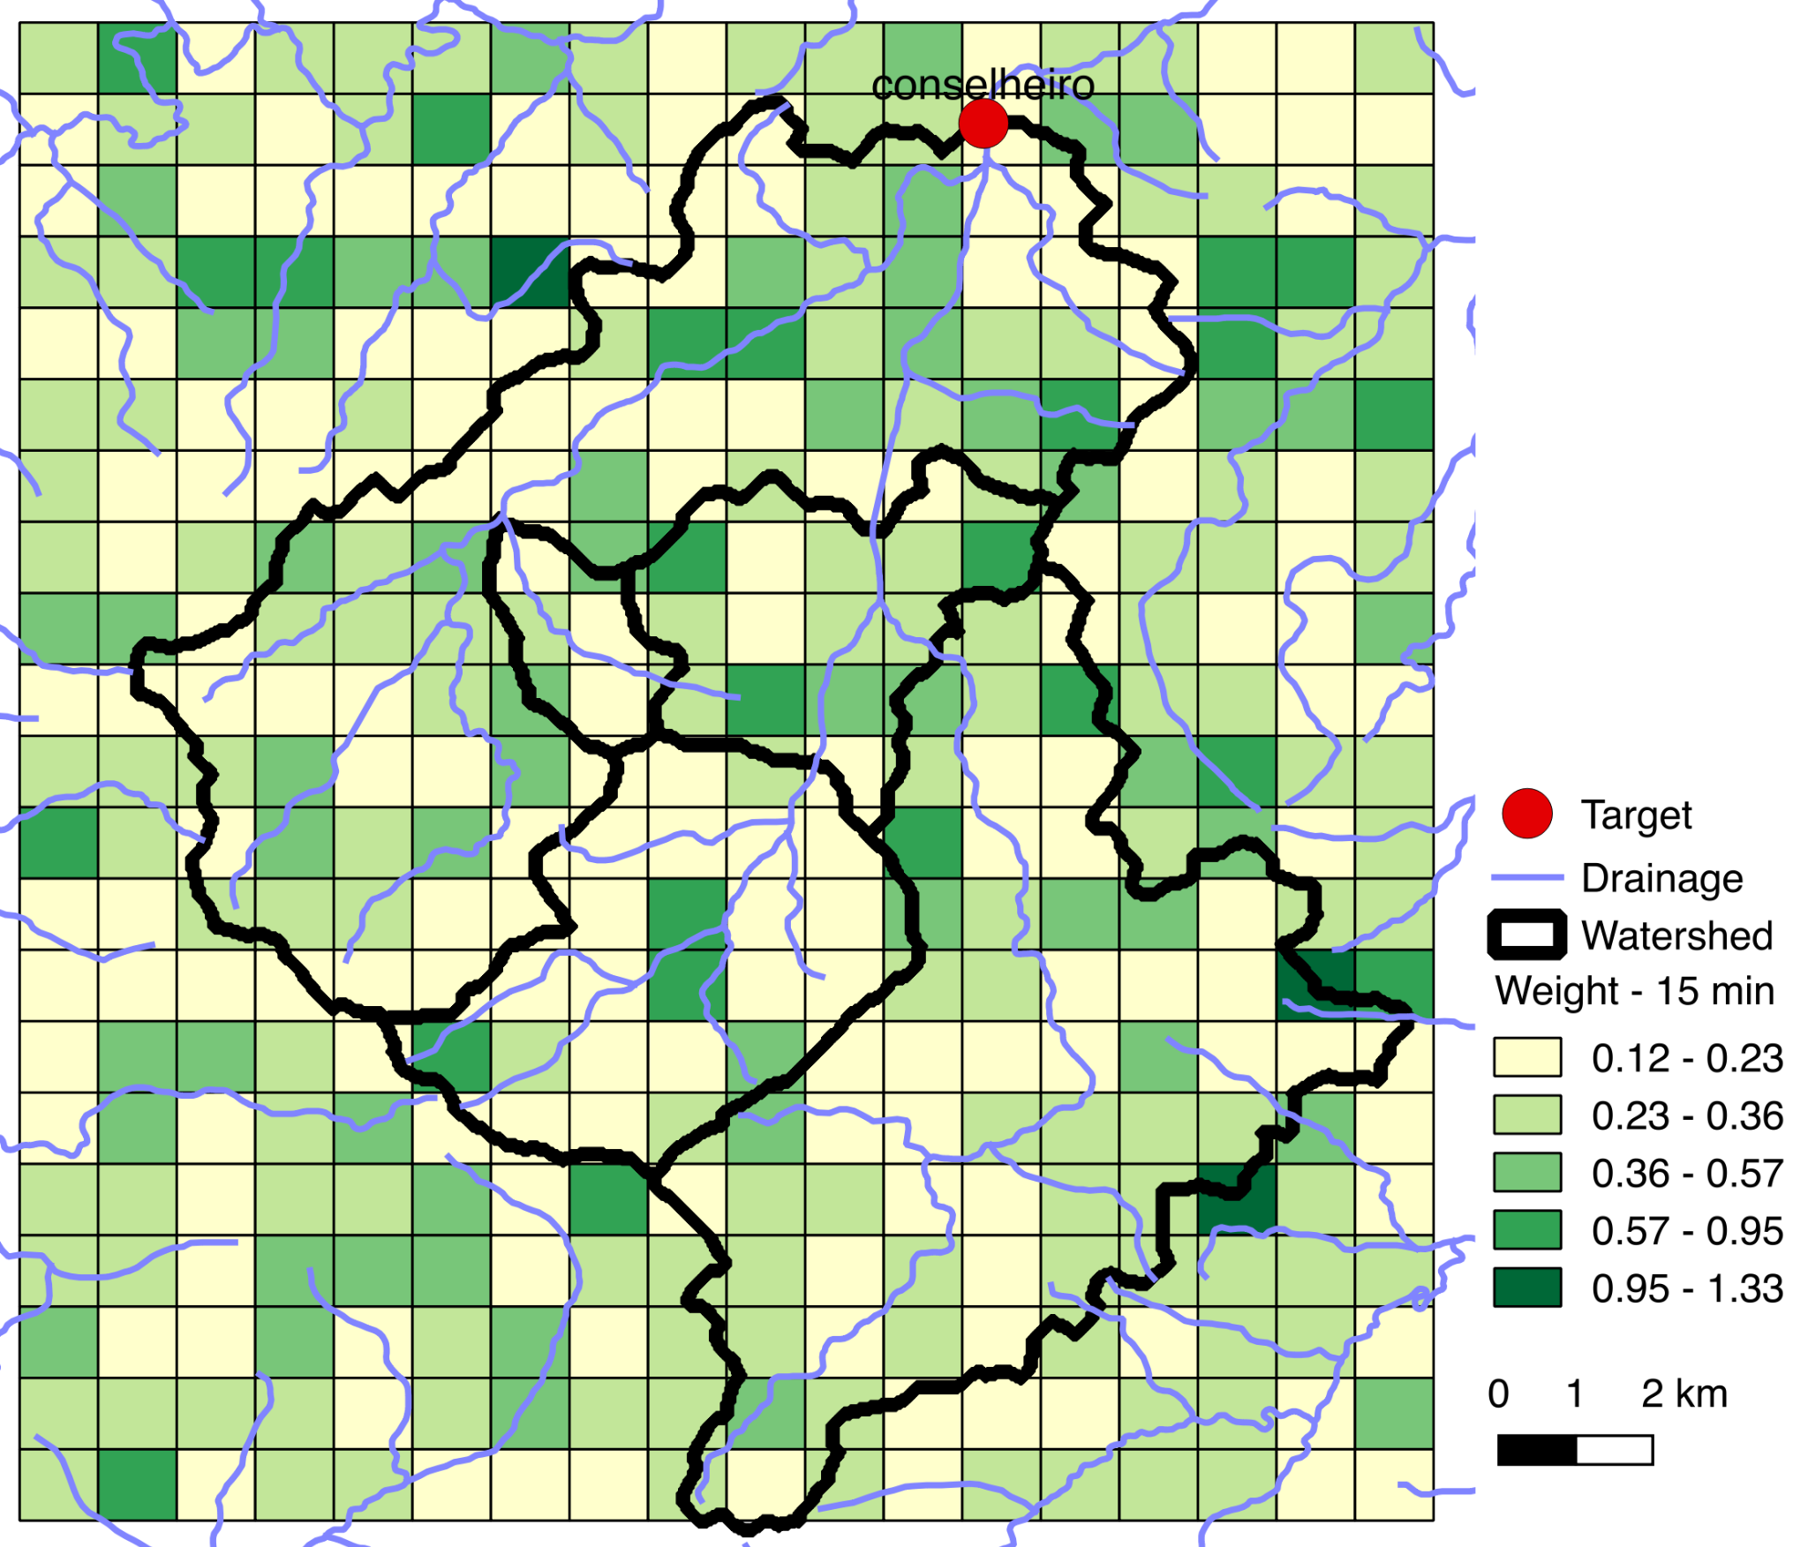
Weight analysis
Weights - Accum 12h - Predict to 15 min.
Source: author production
49

Slide 50
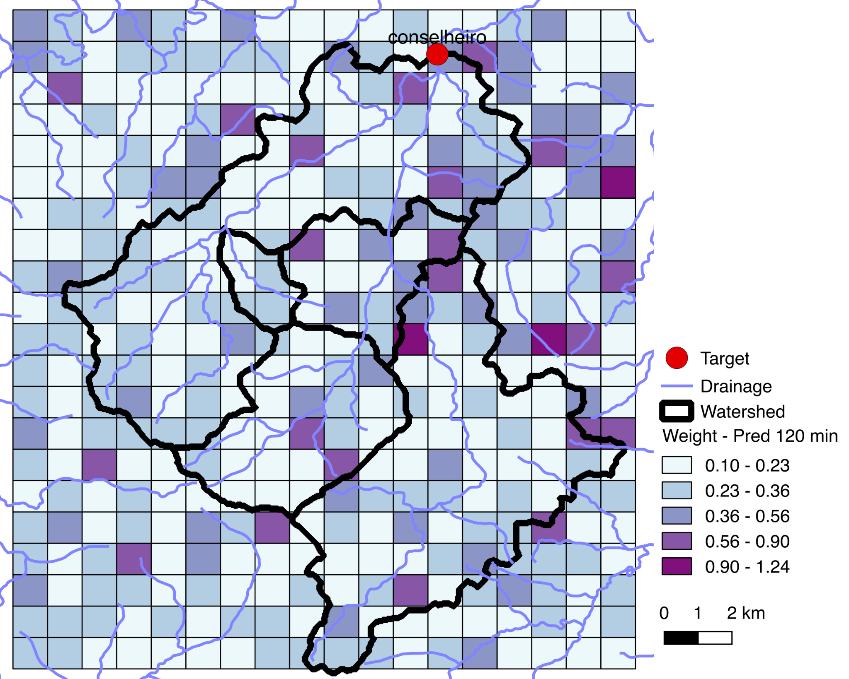
Weight analysis
Weights - Accum 12h - Predict to 120 min.
Source: author production
50

Slide 51
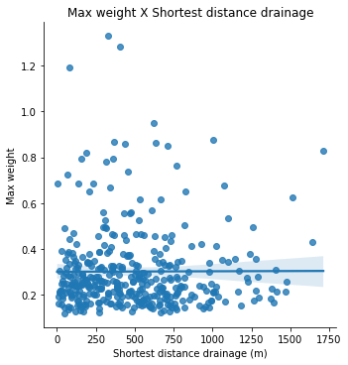
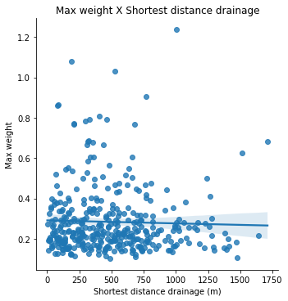
Weight analysis
Max weight
X
Shortest distance between radar cell center and drainage
Accum 12h - Predict to 15 min.
Accum 12h - Predict to 120 min.
51

Slide 52

Sensitivity analysis
52

Slide 53
Sensitivity analysis
Evaluates the sensitivity of the network in relation to each of the input variables
Prec. Ypu
Prec. Venda das Pedras
Prec. Suspiro
Prec. Olaria
Prec. Cons. Paulino
Level Ypu
Level Venda das Pedras
Level Suspiro
Level Olaria
Level Cons. Paulino
53

Slide 54
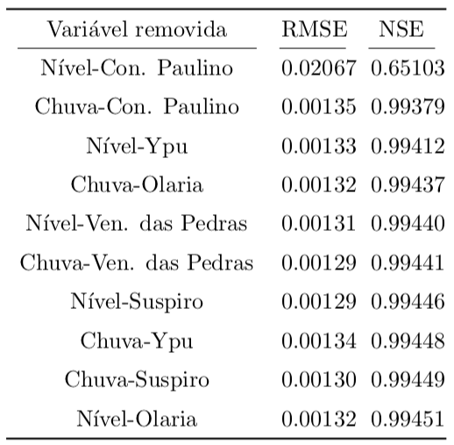
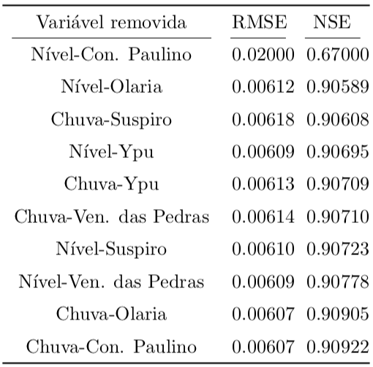
Sensitivity analysis
Análise de Sensibilidade
(Freitas, Silva, Santos, 2021)
Antecedence: 15 minutes
Antecedence: 120 minutes
Source: author production
54

Slide 55
New test dataset
Tests with the network trained with station data…
55

Slide 56
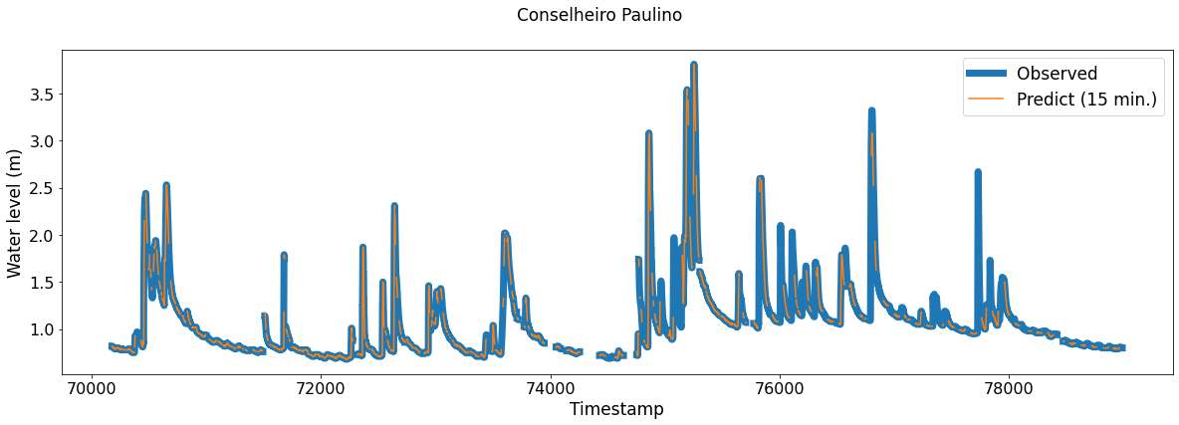
Recent dataset
01/01/2018 to 31/03/2018
NSE = 0.9927
Source: author production
56

Slide 57
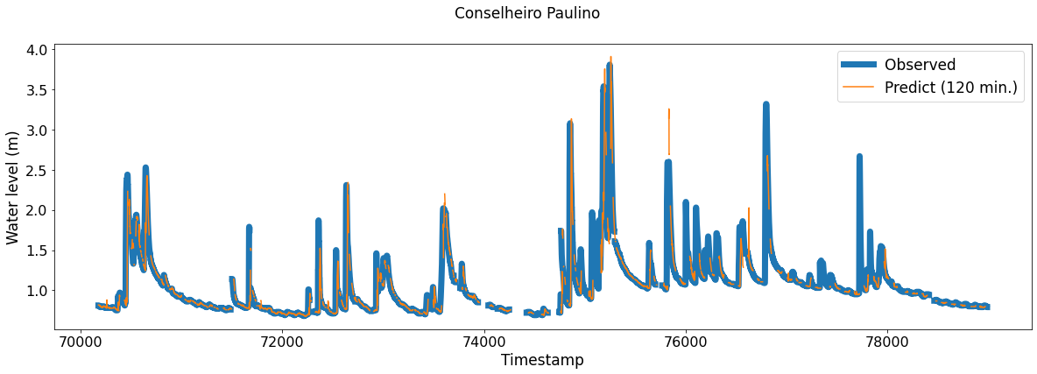
Recent dataset
01/01/2018 to 31/03/2018
NSE = 0.8448
Source: author production
57

Slide 58
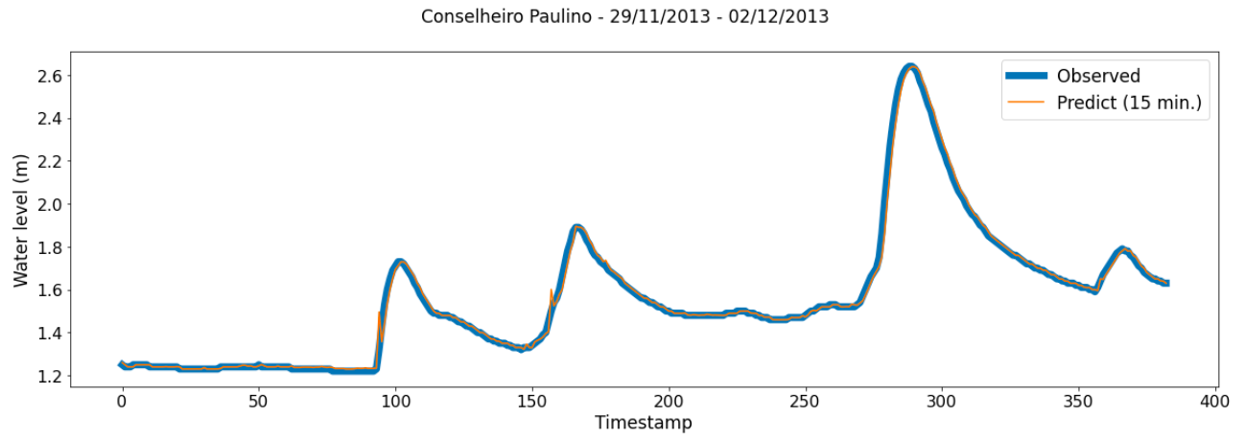
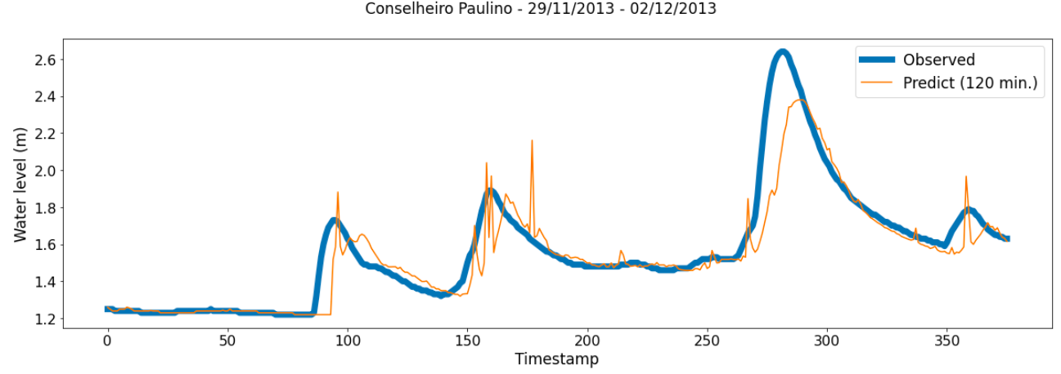
Dataset with flash floods
NSE = 0.9937
NSE = 0.8042
Source: author production
58

Slide 59
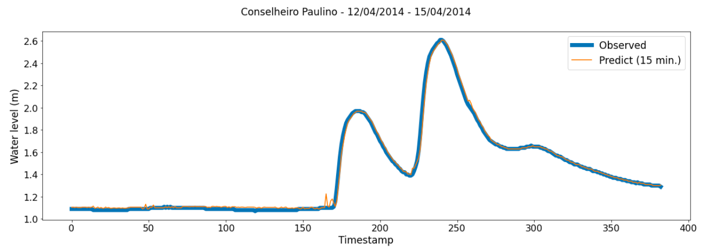
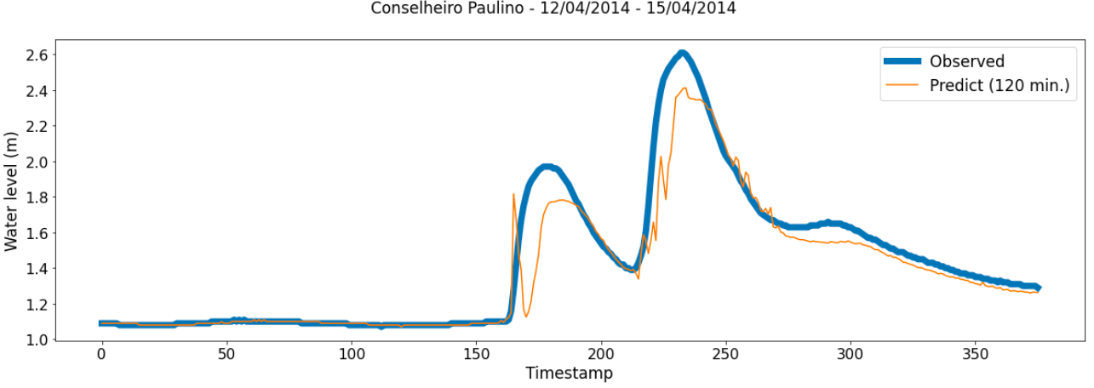
Dataset with flash floods
NSE = 0.9949
NSE = 0.8805
Source: author production
59

Slide 60
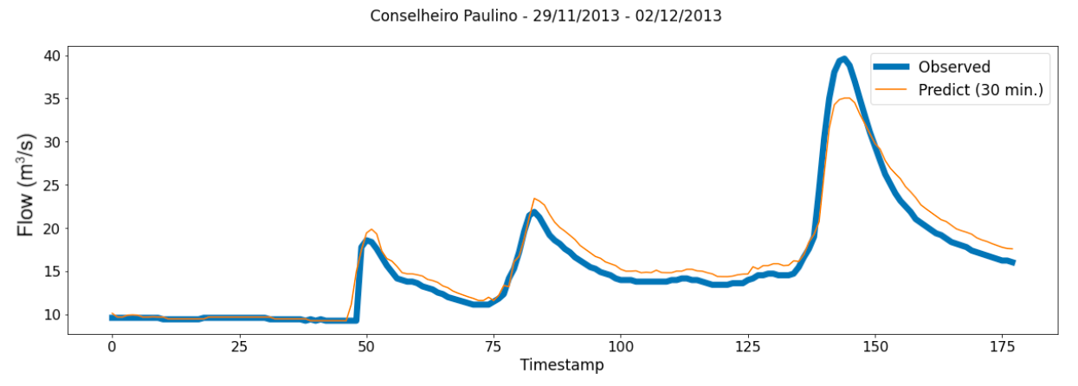
Flow prediction
Input - Flow to Conselheiro Paulino
Output - Flow to Conselheiro Paulino after 30 minutes
NSE = 0.94765
Source: author production
60

Slide 61
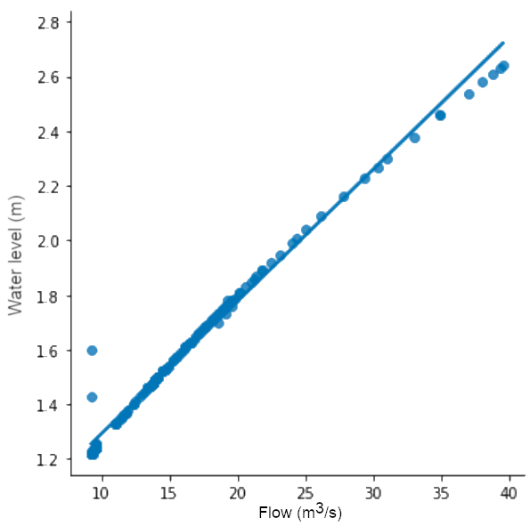
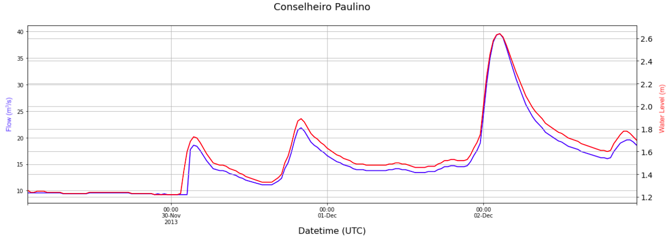
Flow prediction
Rating curve
Source: author production
61

Slide 62
Better results
Input | Antecedence | RMSE | NSE
Station (Water level + Rainfall) | 15 min. | 0.0013 | 0.9944
Radar (Accum 12h) | 15 min. | 0.0380 | 0.8779
Station (Water level + Rainfall) | 120 min. | 0.0063 | 0.9016
Radar (Accum 12h) | 120 min. | 0.0416 | 0.8590
A model based on neural networks can present good results, even when we compared to a physical model: in BACELAR (2017), considering the same watershed and period, the obtained NSE was 0.56 for the flow forecast
Simple architecture
Satisfactory results
62

Slide 63
Final remarks - Conclusions
Both networks: good results to predict temporal series of water level, including for 2 hours in advance
The proposed approach indicates a possible use of ANNs for hydrological forecasting in an operational scenario
Network trained with station data showed good results even after 5 years
Weight: no physical relationship
Sensitivity: possible physical meaning
63

Slide 64
Final remarks - Contributions
Source code and dataset are available for download (model trained with rainfall data from hydrological stations)
https://github.com /cpfreitas/networks_neurais/
64

Slide 65
Final remarks
Limitation
Availability of historical and continuous data
Future works
Use of network in other watershed and implementation with other architectures
Operational applications
65

Slide 66
References
FREITAS, C. P., DINIZ, M. M., de LIMA, G. R. T., QUILES, M. G., STEPHANY, S. and SANTOS, L. B. L. Combining Rainfall and Water Level Data for Multistep High Temporal Resolution Empirical Hydrological Forecasting, In: Anais do XXIII ENMC – Encontro Nacional de Modelagem Computacional e XI ECTM – Encontro de Ciências e Tecnologia de Materiais, Palmas-TO, 798–807, 2020.
FREITAS, C. P.; SILVA, E. J.; SANTOS, L. B. Análise de sensibilidade em uma rede neural para previsão hidrológica de alta resolução temporal. In: XL Congresso Nacional de Matemática Aplicada e Computacional - CNMAC. Evento Virtual, Co-organizado pela Universidade do Mato Grosso do Sul (UFMS), 2021. v. 8, n. 1, p. 010025–1.
BACELAR, L. C. S. D. Prognósticos de inundações bruscas utilizando conjuntos de previsões em curto prazo de radar meteorológico. 2017. 179 p. Mestrado em Meteorologia — Instituto Nacional de Pesquisas Espaciais (INPE), São José dos Campos, 2017.
66

Slide 67
References
KIA, M. B.; PIRASTEH, S.; PRADHAN, B.; MAHMUD, A. R.; SULAIMAN, W. N. A.; MORADI, A. An artificial neural network model for flood simulation using GIS: Johor River Basin, Malaysia. Environmental Earth Sciences, v. 67, n. 1, p. 251–264, 2012. ISSN 1866-6299.
LIMA, G. R. T. de; SANTOS, L. B. L.; CARVALHO, T. J. de; CARVALHO, A. R.; CORTIVO, F. D.; SCOFIELD, G. B.; NEGRI, R. G. An operational dynamical neuro-forecasting model for hydrological disasters. Modeling Earth Systems and Environment, v. 2, n. 6684, 2016. ISSN 2363-6211.
SUNG, J. Y.; LEE, J.; CHUNG, I.M.; HEO, J.H. Hourly water level forecasting at tributary affected by main river condition. Water, v. 9, n. 9, 2017. ISSN 2073-4441.
Nur Adli Zakaria, M.; Abdul Malek, M.; ZOLKEPLI, M.; Najah Ahmed, A. Application of artificial intelligence algorithms for hourly river level forecast: A case study of muda river, malaysia. Alexandria Engineering Journal, v. 60, n. 4, p. 4015–4028, 2021. ISSN 1110-0168.
67

Slide 68
Neural network for very short-term hydrological forecasting
Thanks!
Master’s Dissertation in Applied Computing
cintia.cpfreitas@gmail.com

